Slide 1


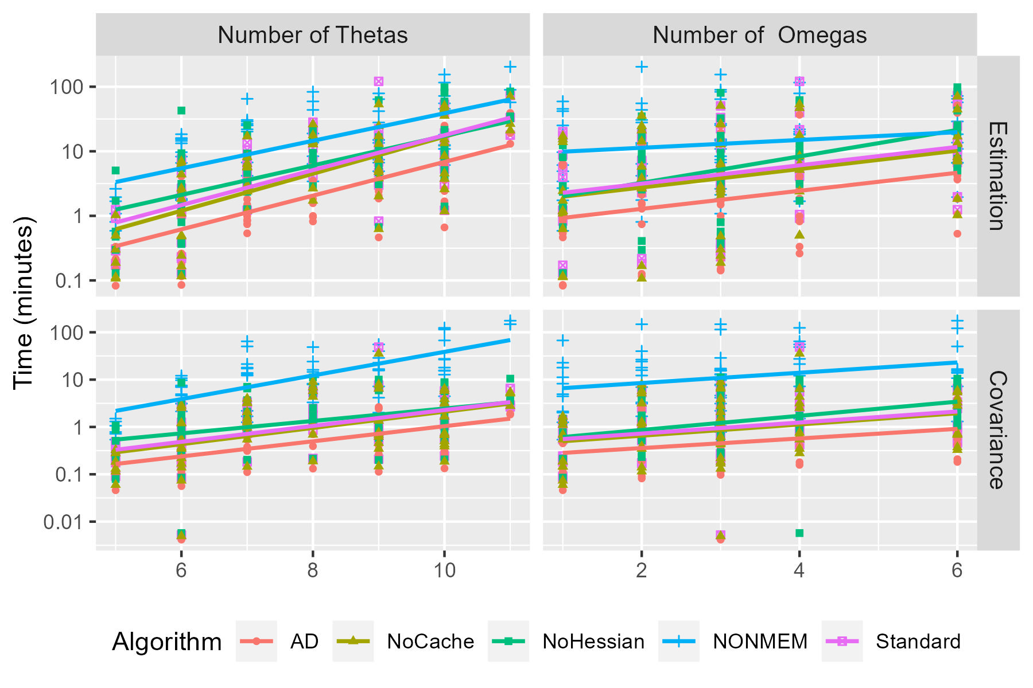
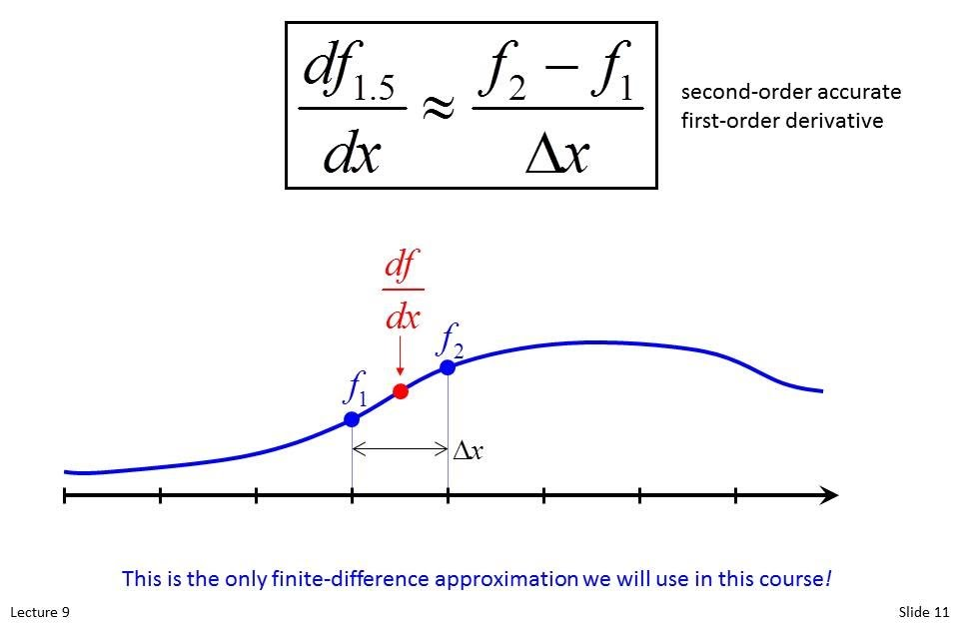
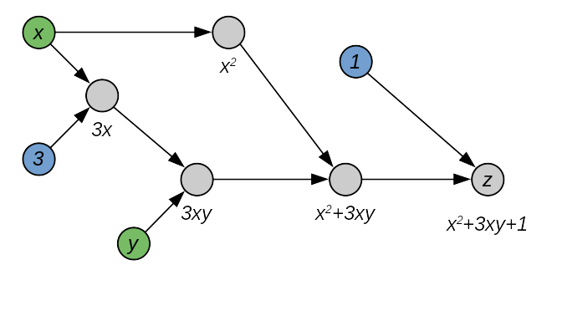

Automatic differentiation, a possible solution to numerical instability in Population PK parameter estimation
Rong Chen (1) Mark Sale (1), Alex Mazur (1), Michael Tomashevskiy(1), Shuhua Hu(1), Robert Leary (1), Mike Dunlavey (1) James Craig (1), Keith Nieforth (1)
Institution: (1) Certara
Background & Objectives:
Performance of nonlinear mixed effects models has been a limiting factor in its application to pharmacometrics since the methods were first introduced with both NONMEM (1) and NLME (2). Algorithm developments in the methods, such as conditional methods (3), while improving the accuracy of parameter estimates have typically substantially increased the run time. In addition, it may be the case that conditional methods result in reductions in the numerical robustness of the model, resulting in models with unrecoverable numerical errors, failure to converge, and/or non-positive covariance matrices. We hypothesize that the issues of speed and robustness seen with the first order conditional methods are at least in part related to poor estimates of the first derivative of the conditional parameters WRT the objective function value (OFV) using the finite difference (FD) method (4) and to poor initial estimates of the Hessian matrix for the conditional parameters.
Finite Difference vs Automatic Differentiation
Finite difference is an approximation to the first derivative of the parameter WRT the OFV based on calculating the OFV at two or more points, then dividing the change in the OFV by the difference in the parameter. This is shown in figure 1.
Automatic differentiation is an exact method that consists of recursively applying the chain rule to the OFV as in figure 2. This approach is applied only in the conditional step to estimate individual ETAs.
Methods:
Versions of NMLE were developed that included:
FD gradient calculation with Hessian propagation (standard)
FD gradient calculation without Hessian propagation (NoHessian)
AD gradient calculation with Hessian propagation (ADPO)
FD without Caching (NoCache)
For reference, NONMEM (version 7.4) was also run. A set of models for benchmarking was developed. Seventy-two models with Michaelis-Menten elimination were simulated using pyDarwin (6). The DVERK ODE solver was used in NLME and the same ODE solver (ADVAN6) in NONMEM. These 72 models consisted of:
1, 2 or 3 compartments
V as a power function of Weight or unrelated to Weight
Without or without a Gamma parameter for the Michaelis-Menten term
With and without between-subject variability (BSV) on Vmax, Km, V2, and Ka, with diagonal or block structure for OMEGA. The simulated data set included 60 subjects, with weights drawn from a log-normal distribution with a geometric mean weight of 70 kg and CV of 0.2. All models had first-order absorption with no absorption lag time. Sampling times were:
0.5,2,6,12,24,48,96,120. The same 72 data sets were used for all algorithms. The initial estimates for all models (both NLME and NONMEM) were set to the values used to simulate that model. This resulted in a range of the number of estimated THETAs from 5 to 11 and the number of estimated OMEGAs from 1 to 6.
Methods:
The simulation models were then used to estimate parameters for each simulated data set using the methods. In the interest of time, all models were set to time out after 6 hours of wall clock time. All models were run using a single core and no other computationally intensive executables were run during the benchmark. Only a single model at a time was run on a 4 core computer. The computer was rebooted between algorithm runs. Comparison is then made for estimation time, covariance time, estimation success, and covariance success for models that did not time out and did not have unrecoverable numerical errors.
Results:
A set of 61 of the 72 models that did not time out and did not crash was included for the speed benchmark. All 72 models were included in the analysis of convergence, covariance. 10 models were removed as they crashed or timedout out in NONMEM, 1 model was removed from the AD and Standard set as it had a return code of 7.
Convergence/Covariance
Figure 1. Finite difference calculation, From https://www.youtube.com/watch?v=v-exTNOSG3g
Figure 2, recursive chain rule
Algorithm | Converge (%) | Covariance (%)
AD | 98.6 | 98.6
NONMEM | 70.8 | 83.3
NoCache | 100 | 97.2
NoHessian | 100 | 97.2
Standard | 98.6 | 97.2
Discussion:
AD resulted in significant improvement in speed, a roughly two fold increase compared to FD. We were unable to determine any effect on convergence and covariance, as with NLME only 1 model failed to converge and 2 did not have a successful covariance step with standard NLME. This model returned a code of 7 (error in line search) that resulted in clearly non-optimal parameters and so was counted as a failure to converge. Work continues to improve the performance of the underlying NLME engine. Code to run this benchmark for NONMEM and standard NLME is available at:
www.XXXXX.XXXXX
A complimentary 30 day license for standard NLME is available on request by contacting support@certara.com for users interested in running the benchmark.
[1) https://www.iconplc.com/solutions/technologies/nonmem
[2] https://www.certara.com/software/phoenix-nlme/.
(3) https://ascpt.onlinelibrary.wiley.com/doi/10.1002/psp4.12422
(4) https://en.wikipedia.org/wiki/Finite_difference_method
(5) https://en.wikipedia.org/wiki/Automatic_differentiation
(6) Li, X., Sale, M., Nieforth, K., Bigos, K.L., Craig, J., Wang, F., Feng, K., Hu, M., Bies, R. and Zhao, L. (2024), pyDarwin: A Machine Learning Enhanced Automated Nonlinear Mixed-Effect Model Selection Toolbox. Clin Pharmacol Ther, 115: 758-773. https://doi.org/10.1002/cpt.3114
Want to learn more? << Scan Here

